Slide 1

How to Train Your Dragon and Its Friends: AI on the Edge with Eclipse Kura
Pierantonio Merlino
Mattia Dal Ben
Eurotech

Slide 2




Outline
Who are we?
Why AI on the Edge?
Know your dragon: Eclipse Kura AI APIs
What problem are we going to solve today?
Introduction to Anomaly Detection
Tutorial
Further examples
Upcoming features

Slide 3

Who are we?
Pierantonio Merlino was born in Udine, Italy, in 1980. He graduated in Electronic Engineering (summa cum laude) from the University of Udine, Italy, in 2005 and he received a Ph.D. degree at the same University in 2009. After several years in hardware research, he switched to software development. He joined Eurotech in 2014 and started working on ESF. He is Eclipse Kura committer since 2015.
Mattia Dal Ben Master graduated in Electronic Engineering at the University of Udine, Italy. He is currently working as Software Engineer at Eurotech in the ESF team. He worked on multiple deep learning projects concerning image processing and anomaly detection.

Slide 4
Why AI on the Edge?
Edge AI is the deployment of AI applications in devices close to where the data are located and collected.
It puts together the best of two worlds:
Lower latency, lower network requirements, increased privacy, …
Smart Machine Learning applications applied to collected data
Eclipse Kura is a good candidate to apply Edge AI concepts to the real world due to its modularity, capability to collect data from field devices and publish on the cloud.
Notes:
https://blogs.nvidia.com/blog/2022/02/17/what-is-edge-ai/
Edge AI is the deployment of AI applications in devices throughout the physical world. It’s called “edge AI” because the AI computation is done near the user at the edge of the network, close to where the data is located, rather than centrally in a cloud computing facility or private data center.
Since the internet has global reach, the edge of the network can connote any location. It can be a retail store, factory, hospital or devices all around us, like traffic lights, autonomous machines and phones.

Slide 5
Know your dragon: Eclipse Kura AI APIs

Slide 6
Know your dragon: Eclipse Kura AI APIs
Kura 5.1.0 introduced a new set of APIs for managing Inference Engines [1,2]
An Inteference Engine is a library or a service that accepts multiple files describing an AI and ML models and allow to perform inference on data.
The first implementation is based on the Nvidia™ Triton Inference Server [3, 4]
Notes:
Perchè nvidia triton server? Maturo, supportato, alta compatibilita con bachends e maggiori librerie di deep learning.

Slide 7
Nvidia™ Triton Inference Server
The Nvidia ™ Triton Server is an open-source inference service software that enables the user to deploy trained AI models from any framework on GPU or CPU infrastructure.
It supports all major frameworks like TensorFlow, TensorRT, PyTorch, ONNX Runtime, and even custom framework backend.
It is provided in native and container fashion
GPU and CPU accelerated

Slide 8
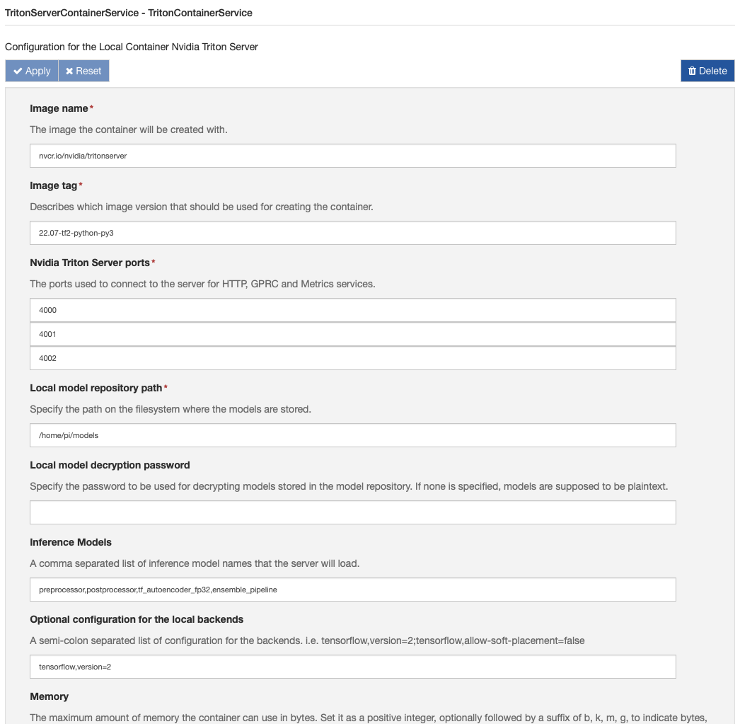
Know your dragon: Eclipse Kura AI implementation
Kura provides three components for exposing the Triton Server service functionality [5, 6]:
TritonServerRemoteService
TritonServerNativeService
TritonServerContainerService
Model encryption: your AI models are important: let’s encrypt them!

Slide 9
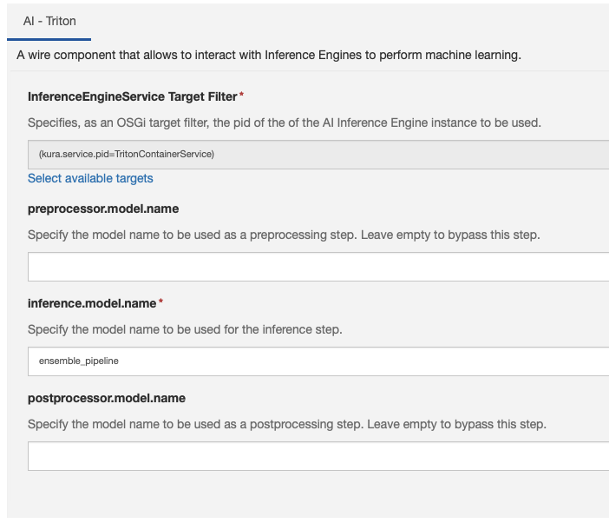
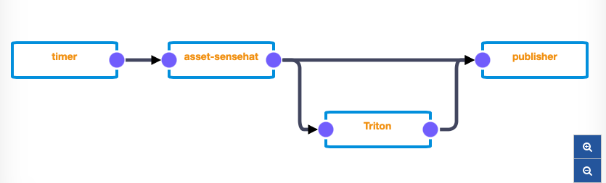
Know your dragon: Eclipse Kura AI Wire component
The AI Wire Component can power up your Wire Graph!

Slide 10
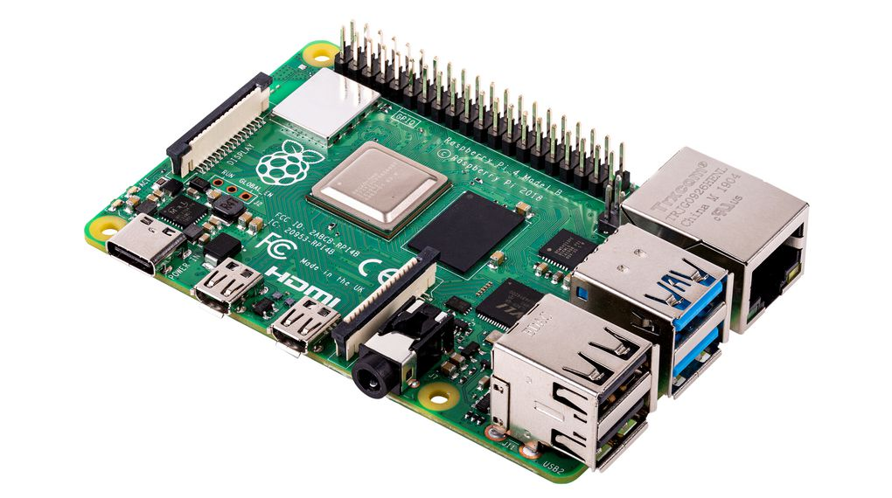
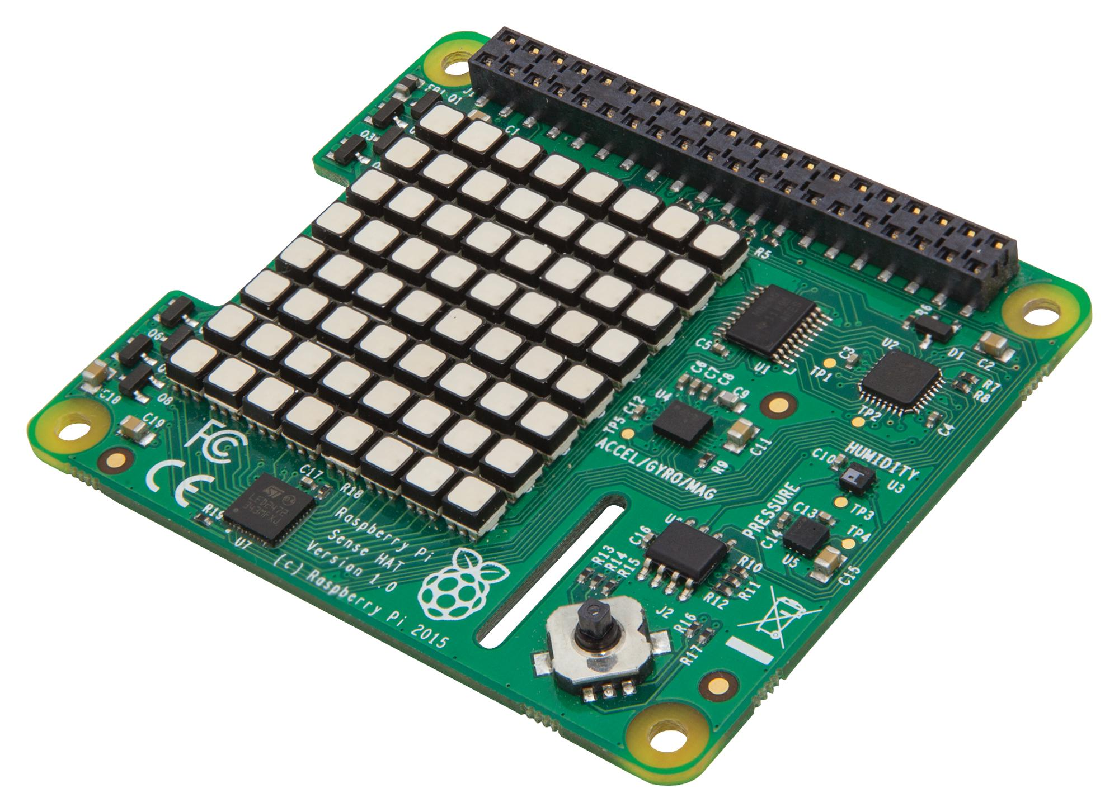
What problem are we going to solve today?
We'll focus on the process of creating a deep learning anomaly detector from scratch, leveraging the entire Eclipse Kura ecosystem:
Data collection
Model building and training
Model Deployment

Slide 11
Introduction to Anomaly Detection

Slide 12

What is an Anomaly?
A pattern in data that do not conform to a well-defined notion of normal behavior [7].
A data point which differs significantly from other data points.
An observation which deviates so much from other observations as to arouse suspicions that it was generated by a different mechanism [8].
https://unsplash.com/photos/0inyFl3j_rc

Slide 13

Why Anomaly Detection?
The importance of anomaly detection is due to the fact that anomalies in data translate to significant (and often critical) actionable information in a wide variety of application domains [7].
Finding anomalies is useful in several domains as cyber security, industry, IoT, robotics, etc.
Anomaly detection can be applied for intrusion and fraud detection, fault detection, etc.
https://unsplash.com/photos/fiXLQXAhCfk

Slide 14

How to detect anomalies?
Statistical analysis:
Threshold, proximity and deviation
Machine Learning algorithms:
Supervised
Decision trees, XGBoost, …
Semi-supervised
Autoencoders, …
Unsupervised
GANs, …
https://xkcd.com/1838/

Slide 15
What IS aN Autoencoder?
An Autoencoders is a specific semi-supervised (or self-supervised) ML algorithm used in several applications
An Autoencoder tries to reconstruct the input at the output
It consists of an Encoder and a Decoder
The Encoder is a NN that maps the input to a lower-dimensional space (code)
The Decoder is a NN that maps encoded data back to the input
The algorithm is trained to have a small reconstruction error
Anomalies tipically have high reconstruction error (MAE, MSE or RMSE)
Input: X
Output: X’
X – X’
Reconstruction Error

Slide 16
Tutorial

Slide 17

Tutorial
https://colab.research.google.com/github/mattdibi/eclipsecon-edgeAI-talk/blob/master/notebook/AD-EdgeAI.ipynb

Slide 18
Upcoming features
Support for more ML backends:
Intel™ OpenVINO ™
Eclipse Deeplearning4j
Contributions are welcome!

Slide 19
Questions?

Slide 20
Interested in the cover image?
Look here!
https://labs.openai.com/s/kDAkiocHXgKDY0j3utSLFPlj

Slide 21
REFERENCES
[1] https://github.com/eclipse/kura/blob/KURA_5.1.0_RELEASE/kura/distrib/RELEASE_NOTES.txt
[2] https://github.com/eclipse/kura/tree/develop/kura/org.eclipse.kura.api/src/main/java/org/eclipse/kura/ai/inference
[3] https://developer.nvidia.com/nvidia-triton-inference-server
[4] https://github.com/triton-inference-server
[5] https://github.com/eclipse/kura/blob/KURA_5.2.0_RELEASE/kura/distrib/RELEASE_NOTES.txt
[6] https://eclipse.github.io/kura/docs-release-5.2/core-services/nvidia-triton-server-inference-engine/
[7] Chandola, V.; Banerjee, A.; Kumar, V. (2009). "Anomaly detection: A survey". ACM Computing Surveys. 41 (3): 1–58. doi:10.1145/1541880.1541882. S2CID 207172599.
[8] Hawkins, Douglas M. (1980). Identification of Outliers. Chapman and Hall London; New York.

